Slide 1


Testing Clean Architecture
Remigiusz Dudek
Software Quality Engineer

Slide 2

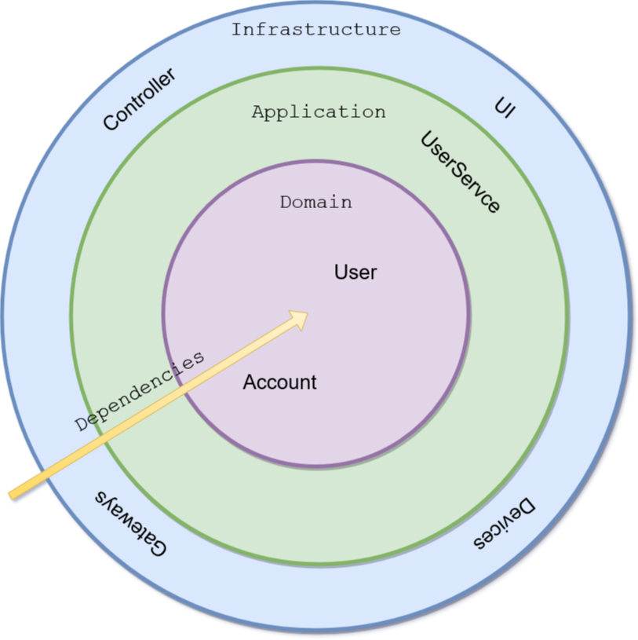
Clean architecture
(In)Dependency rule
Infrastructure
Communication with external world
Translation (e.g. json to application model)
Application layer
Authentication/Authorization
Thread synchronization
Usecase orchiestration
Domain
Business logic

Slide 3
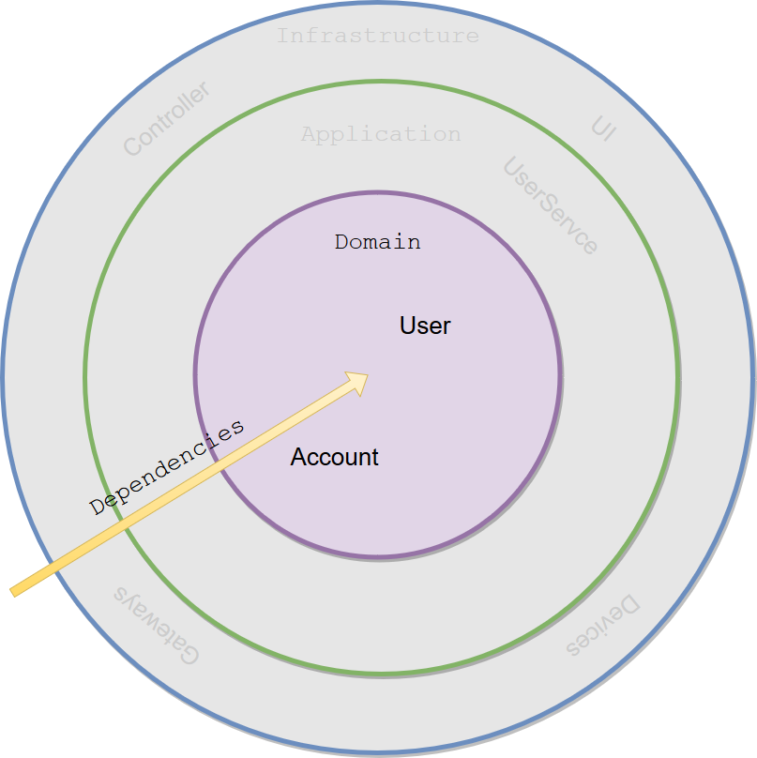
Unit tests - domain
Test business logic
Beware that mocks breaks this rule
Functor approach instead of mocks
Don’t mock your business objects
Action of last resort
Use only public interface of the class
Law of Demeter
Domain Driven Design aggregate
Access modifiers
Test examplifies unit usage
Notes:
Do not mock your business objects
Using mocks breaks the principle of testing business functionality as suddenly a test is aware of an internal implementation
Using mocks clutters the test, especially when there is a default behaviour of a mock which is then overriden in some aspect by each test
Use mocks as a last resort action when testing application services
https://martinfowler.com/bliki/UnitTest.html

Slide 4
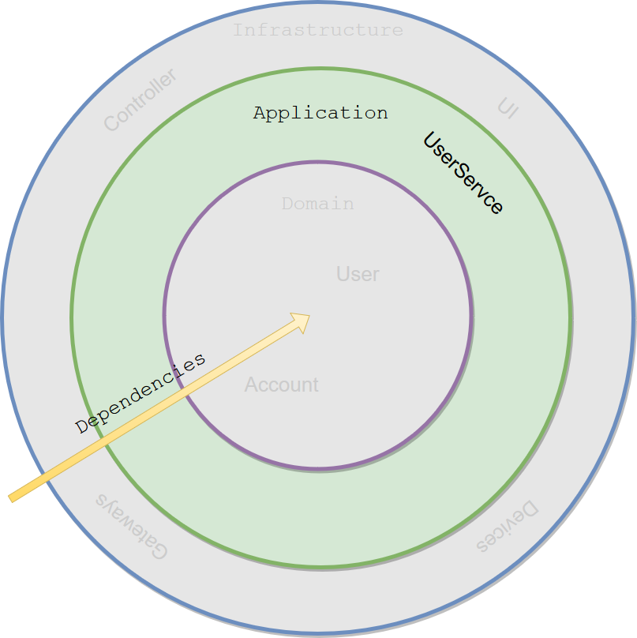
Unit tests - app
Treat it as exception not a rule
Use only when there is a business logic in application services (sic!) – there should not be business logic in app layer

Slide 5
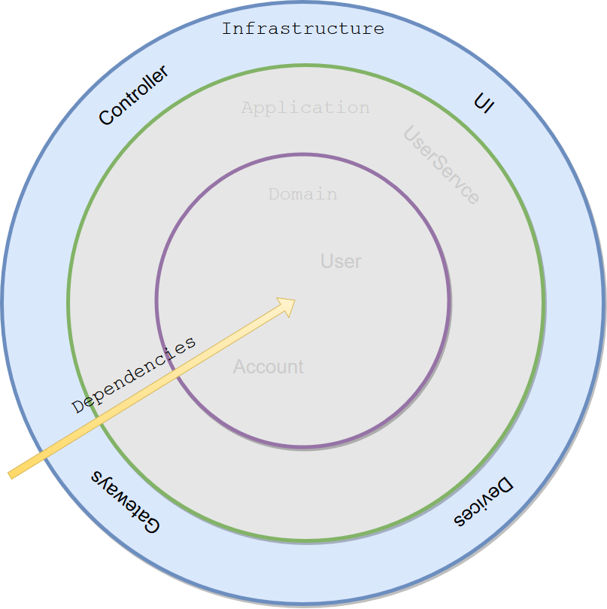
Unit tests - infra
If you have a need to unit test infra classes it is a red flag
Responsibility of this layer is to integrate your application with the outer world

Slide 6
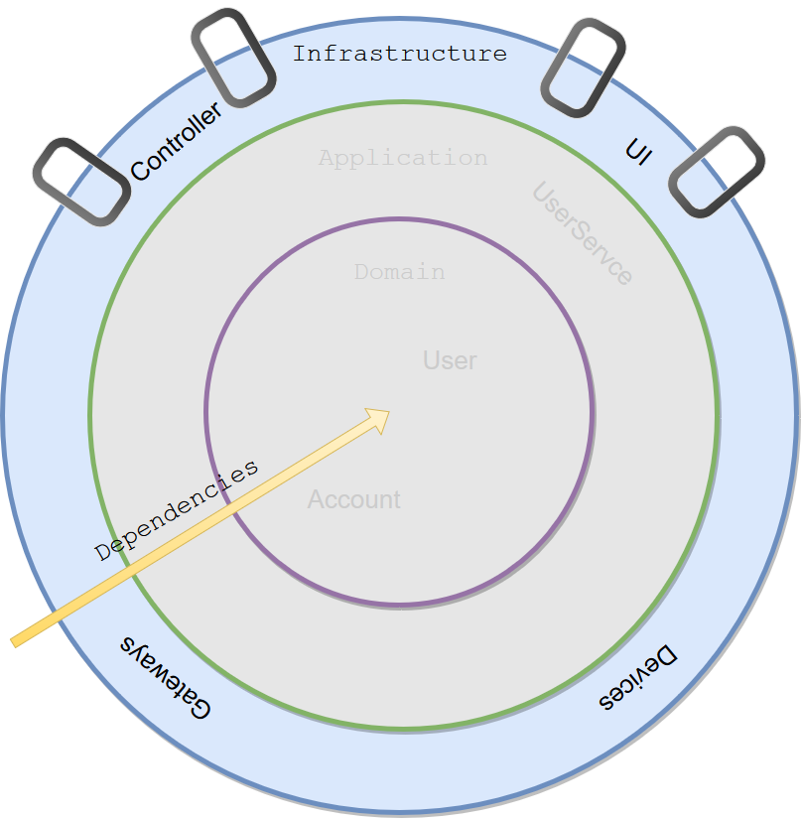
Integration tests – infra-outer
Run DB and test your ORM
Use device emulators
Anti-corruption layer – prevent spoiling your model by models from outer world
Notes:
External services with stable API can be tested on this level (usnig WireMock for example)
Internal services under development should be tested with Contracts

Slide 7
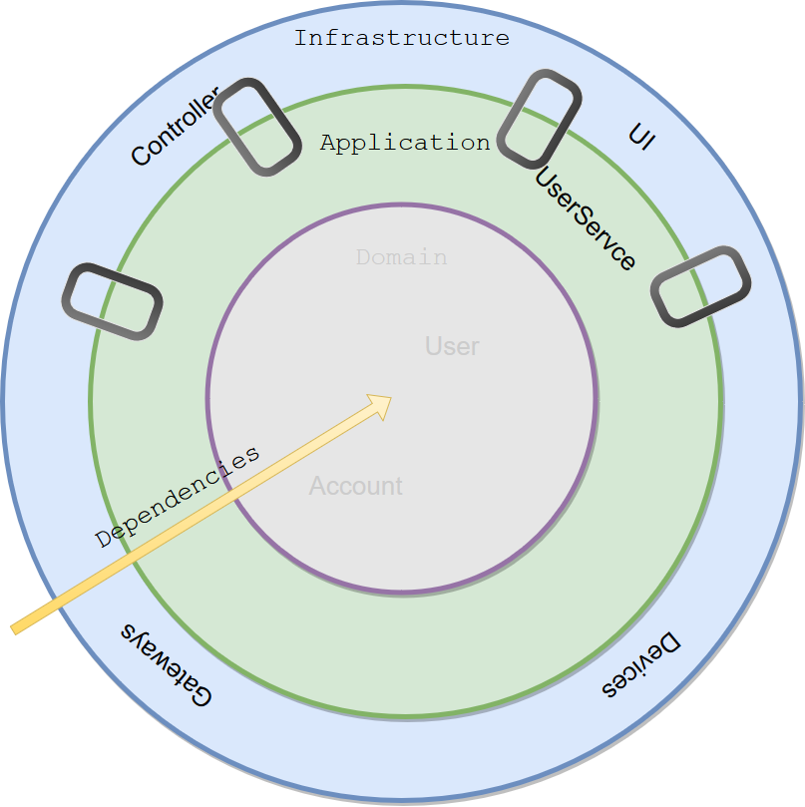
Integration tests – infra-app
It is tested on compilation level
Ensure that application layer can consume all valid objects produced by infrastructure

Slide 8
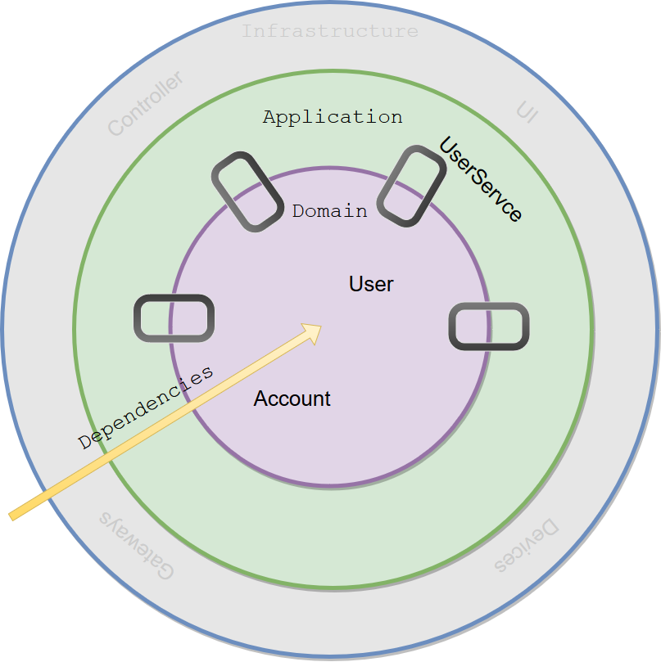
Integration tests –app-domain
Refactoring a convoluted domain
Push as many tests as possible to lower level
Can we have Integration test within Domain layer?
Notes:
If it is more convenient to create „integration” test a not unit test within a single layer, maybe we’ve created an aggregate (in DDD sense) and as such all rules of the aggregate should apply

Slide 9
Component tests
Use only business API of the application
Detach waiting from assertion
Ideally you should not have two system tests going through the same method in any Application Service

Slide 10
End to End tests Contracts
Consumer Driven Conracts
Mock vs real service similarity

Slide 11
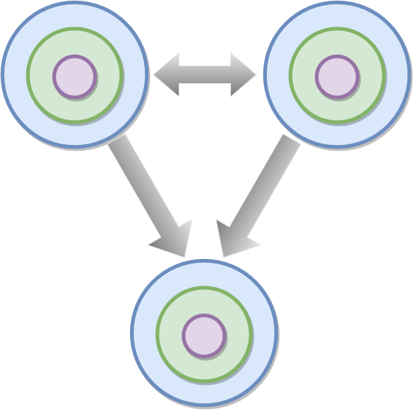
End to End tests
Handfull of real e2e tests
Problems
Environment
cost (many services)
bottleneck (which versions)
unstability
Test analysis
Feedback loop
Test isolation
Consider semantic monitoring

Slide 12

App Architecture Sketch
Warehouse
Service
Product
Service

Slide 13
App Architecture Sketch
Warehouse
Service
Product
Service

Slide 14
Warehouse contracts
GET /content
[
{
productId: „id1”,
quantity: 1
},
{
productId: „id2”,
quantity: 2
}
]
Warehouse
Service

Slide 15
Warehouse contracts
PUT /products
[
{
productId: „id1”,
quantity: 1
},
{
productId: „id2”,
quantity: 2
}
]
[
{
productId: „id1”,
status: „SUCCESS”
message: „”
},
{
productId: „id2”,
status: „FAILURE”
message: „some msg”
}
]
Warehouse
Service

Slide 16
References
https://8thlight.com/blog/uncle-bob/2012/08/13/the-clean-architecture.html
https://martinfowler.com/articles/microservice-testing/
https://vaughnvernon.co/?p=838 (Effective Aggregate design)
https://martinfowler.com/bliki/TestPyramid.html
https://cloud.spring.io/spring-cloud-contract/single/spring-cloud-contract.html

